Slide 1
Operations & Supply Chain Management: MBA Session 3
Farida Khan
Source: PowerPoint presentation that accompanies
Heizer and Render

Slide 2
Outline
Forecasting
Inventory management
The Planning Process
Aggregate Planning
Master Production Schedule
Material Resource Planning
Distribution Resource Planning
Enterprise Resource Planning

Slide 3
Demand Forecasting

Slide 4
What is Forecasting?
Process of predicting a future event
Underlying basis of all business decisions
Production
Inventory
Personnel
Facilities
??

Slide 5
Forecasting Time Horizons
Short-range forecast
Up to 1 year, generally less than 3 months
Purchasing, job scheduling, workforce levels, job assignments, production levels
Medium-range forecast
3 months to 3 years
Sales and production planning, budgeting
Long-range forecast
3⁺ years
New product planning, facility location, research and development

Slide 6
Distinguishing Differences
Medium/long range forecasts deal with more comprehensive issues and support management decisions regarding planning and products, plants and processes
Short-term forecasting usually employs different methodologies than longer-term forecasting
Short-term forecasts tend to be more accurate than longer-term forecasts

Slide 7
Types of Forecasts
Economic forecasts
Address business cycle – inflation rate, money supply, housing starts, etc.
Technological forecasts
Predict rate of technological progress
Impacts development of new products
Demand forecasts
Predict sales of existing products and services

Slide 8
Forecasting Approaches
Qualitative Methods
Used when situation is vague and little data exist
New products
New technology
Involves intuition, experience
e.g., forecasting sales on Internet

Slide 9
Forecasting Approaches
Quantitative Methods
Used when situation is ‘stable’ and historical data exist
Existing products
Current technology
Involves mathematical techniques
e.g., forecasting sales of color televisions

Slide 10
Example of Fast Food Restaurant Forecast
20% –
15% –
10% –
5% –
Percentage of sales
11-12 1-2 3-4 5-6 7-8 9-10
12-1 2-3 4-5 6-7 8-9 10-11
(Lunchtime)
(Dinnertime)
Hour of day
Figure 4.12

Slide 11
Example of Call Center Forecast
12% –
10% –
8% –
6% –
4% –
2% –
0% –
2
4
6
8
10
12
2
4
6
8
10
12
A.M.
P.M.
Hour of day
Figure 4.12

Slide 12

Forecasting at Disney World
Global portfolio includes parks in Hong Kong, Paris, Tokyo, Orlando, and Anaheim
Revenues are derived from people – how many visitors and how they spend their money
Daily management report contains only the forecast and actual attendance at each park

Slide 13

Forecasting at Disney World
Disney generates daily, weekly, monthly, annual, and 5-year forecasts
Forecast used by labor management, maintenance, operations, finance, and park scheduling
Forecast used to adjust opening times, rides, shows, staffing levels, and guests admitted

Slide 14

Forecasting at Disney World
20% of customers come from outside the USA
Economic model includes gross domestic product, cross-exchange rates, arrivals into the USA
A staff of 35 analysts and 70 field people survey 1 million park guests, employees, and travel professionals each year

Slide 15
Forecasting at Disney World
Inputs to the forecasting model include airline specials, Federal Reserve policies, Wall Street trends, vacation/holiday schedules for 3,000 school districts around the world
Average forecast error for the 5-year forecast is 5%
Average forecast error for annual forecasts is between 0% and 3%

Slide 16
Inventory Management

Slide 17
Inventory Management
The objective of inventory management is to strike a balance between inventory investment and customer service

Slide 18
Importance of Inventory
One of the most expensive assets of many companies representing as much as 50% of total invested capital
Operations managers must balance inventory investment and customer service

Slide 19
Functions of Inventory
To decouple or separate various parts of the production process
To decouple the firm from fluctuations in demand and provide a stock of goods that will provide a selection for customers
To take advantage of quantity discounts
To hedge against inflation

Slide 20
Types of Inventory
Raw material
Purchased but not processed
Work-in-process
Undergone some change but not completed
A function of cycle time for a product
Maintenance/repair/operating (MRO)
Necessary to keep machinery and processes productive
Finished goods
Completed product awaiting shipment

Slide 21
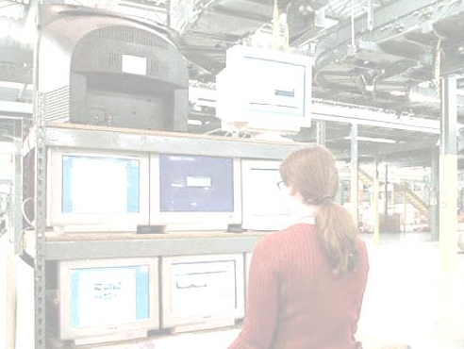
Amazon.com
Amazon.com started as a “virtual” retailer – no inventory, no warehouses, no overhead; just computers taking orders to be filled by others
Growth has forced Amazon.com to become a world leader in warehousing and inventory management

Slide 22

Amazon.com
Each order is assigned by computer to the closest distribution center that has the product(s)
A “flow meister” at each distribution center assigns work crews
Lights indicate products that are to be picked and the light is reset
Items are placed in crates on a conveyor, bar code scanners scan each item 15 times to virtually eliminate errors

Slide 23

Amazon.com
Crates arrive at central point where items are boxed and labeled with new bar code
Gift wrapping is done by hand at 30 packages per hour
Completed boxes are packed, taped, weighed and labeled before leaving warehouse in a truck
Order arrives at customer within 2 - 3 days

Slide 24
Dependant Demand

Slide 25
Dependent Demand
The demand for one item is related to the demand for another item
Given a quantity for the end item, the demand for all parts and components can be calculated
In general, used whenever a schedule can be established for an item
MRP is the common technique

Slide 26
Dependent Demand
Effective use of dependent demand inventory models requires the following
Master production schedule
Specifications or bill of material
Inventory availability
Purchase orders outstanding
Lead times

Slide 27
Dependent Demand
For any product for which a schedule can be established, dependent demand techniques should be used

Slide 28
Dependent Demand
Benefits of MRP
Better response to customer orders
Faster response to market changes
Improved utilization of facilities and labor
Reduced inventory levels

Slide 29
The Planning Process

Slide 30
Planning Horizons
Long-range plans (over one year)
Research and Development
New product plans
Capital investments
Facility location/expansion
Top executives
Intermediate-range plans
(3 to 18 months)
Sales planning
Production planning and budgeting
Setting employment, inventory, subcontracting levels
Analyzing operating plans
Operations managers
Short-range plans (up to 3 months)
Job assignments
Ordering
Job scheduling
Dispatching
Overtime
Part-time help
Operations managers, supervisors, foremen
Responsibility
Planning tasks and horizon
Figure 13.1

Slide 31
The Planning Process
Production
Capacity
Inventory
Marketing
Customer
demand
Finance
Cash flow
Procurement
Supplier
performance
Human resources
Manpower
planning
Management
Return on
investment
Capital
Aggregate production plan
Engineering
Design
completion
Change production plan?
Master production schedule
Figure 14.1

Slide 32
The Planning Process
Master production schedule
Change master production schedule?
Change requirements?
Material requirements plan
Change capacity?
Capacity requirements plan
No
Is capacity plan being met?
Is execution meeting the plan?
Realistic?
Yes
Execute capacity plans
Execute
material plans
Figure 14.1

Slide 33
Aggregate Planning
The objective of aggregate planning is to meet forecasted demand while minimizing cost over the planning period

Slide 34
The Planning Process
Determine the quantity and timing of production for the intermediate future
Objective is to minimize cost over the planning period by adjusting
Production rates
Labor levels
Inventory levels
Overtime work
Subcontracting rates
Other controllable variables

Slide 35
Aggregate Planning
Required for aggregate planning
A logical overall unit for measuring sales and output
A forecast of demand for an intermediate planning period in these aggregate terms
A method for determining costs
A model that combines forecasts and costs so that scheduling decisions can be made for the planning period

Slide 36
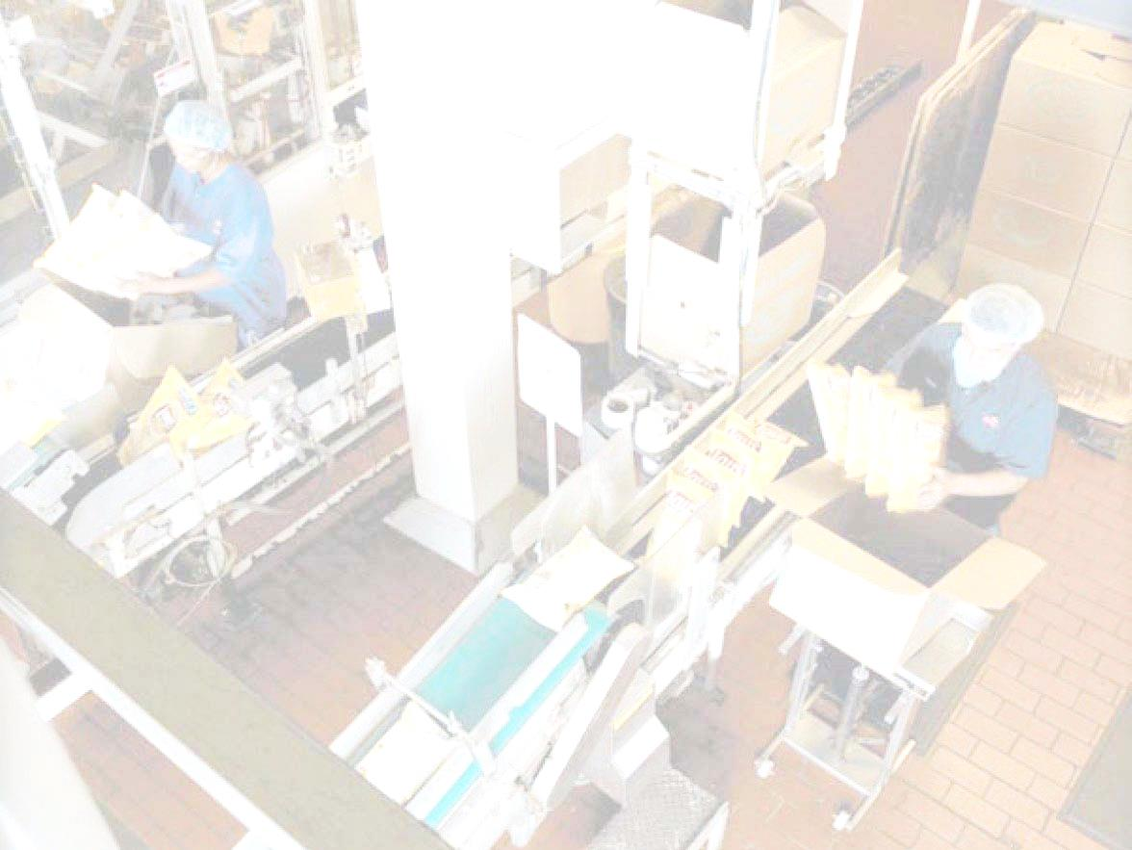
Frito-Lay
More than three dozen brands, 15 brands sell more than $100 million annually, 7 sell over $1 billion
Planning processes covers 3 to 18 months
Unique processes and specially designed equipment
High fixed costs require high volumes and high utilization

Slide 37
Frito-Lay
Demand profile based on historical sales, forecasts, innovations, promotion, local demand data
Match total demand to capacity, expansion plans, and costs
Quarterly aggregate plan goes to 38 plants in 18 regions
Each plant develops 4-week plan for product lines and production runs

Slide 38
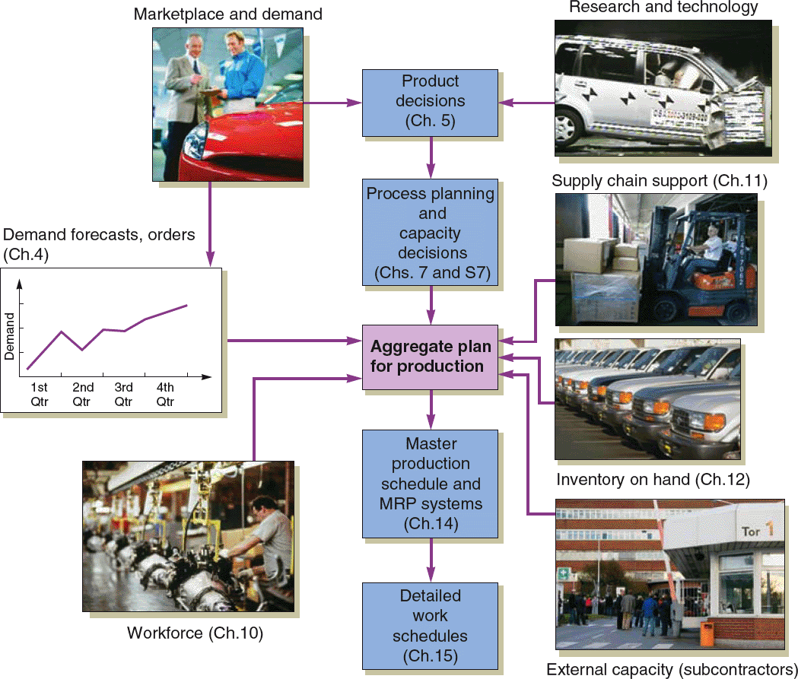
Aggregate Planning
Figure 13.2

Slide 39
Aggregate Planning
Combines appropriate resources into general terms
Part of a larger production planning system
Disaggregation breaks the plan down into greater detail
Disaggregation results in a master production schedule

Slide 40
Aggregate Planning Strategies
Use inventories to absorb changes in demand
Accommodate changes by varying workforce size
Use part-timers, overtime, or idle time to absorb changes
Use subcontractors and maintain a stable workforce
Change prices or other factors to influence demand

Slide 41
MPS & MRP II

Slide 42
Master Production Schedule (MPS)
Specifies what is to be made and when
Must be in accordance with the aggregate production plan
Inputs from financial plans, customer demand, engineering, supplier performance
As the process moves from planning to execution, each step must be tested for feasibility
The MPS is the result of the production planning process

Slide 43
Master Production Schedule (MPS)
MPS is established in terms of specific products
Schedule must be followed for a reasonable length of time
The MPS is quite often fixed or frozen in the near term part of the plan
The MPS is a rolling schedule
The MPS is a statement of what is to be produced, not a forecast of demand

Slide 44
MRP Management
MRP is a dynamic system
Facilitates replanning when changes occur
Regenerating
Net change
System nervousness can result from too many changes
Time fences put limits on replanning
Pegging links each item to its parent allowing effective analysis of changes

Slide 45
MRP and JIT
MRP is a planning system that does not do detailed scheduling
MRP requires fixed lead times which might actually vary with batch size
JIT excels at rapidly moving small batches of material through the system

Slide 46
MRP Structure
Data Files
Output Reports
BOM
MRP by period report
Master
production schedule
MRP by date report
Lead times
(Item master file)
Planned order report
Inventory data
Material requirement planning programs (computer and software)
Purchase advice
Purchasing data
Exception reports
Order early or late or not needed
Order quantity too small or too large
Figure 14.5

Slide 47
Accurate Records
Accurate inventory records are absolutely required for MRP (or any dependent demand system) to operate correctly
Generally MRP systems require more than 99% accuracy
Outstanding purchase orders must accurately reflect quantities and scheduled receipts

Slide 48
Lead Times
The time required to purchase, produce, or assemble an item
For production – the sum of the order, wait, move, setup, store, and run times
For purchased items – the time between the recognition of a need and the availability of the item for production

Slide 49
Bills of Material
List of components, ingredients, and materials needed to make product
Provides product structure
Items above given level are called parents
Items below given level are called children

Slide 50



BOM Example
Level
Product structure for “Awesome” (A)
0
A
1
B₍₂₎ Std. 12” Speaker kit
C₍₃₎
Std. 12” Speaker kit w/ amp-booster
2
E₍₂₎
E₍₂₎
F₍₂₎
Std. 12” Speaker booster assembly
Packing box and installation kit of wire, bolts, and screws
3
D₍₂₎
G₍₁₎
D₍₂₎
Amp-booster
12” Speaker
12” Speaker

Slide 51
Safety Stock
BOMs, inventory records, purchase and production quantities may not be perfect
Consideration of safety stock may be prudent
Should be minimized and ultimately eliminated
Typically built into projected on-hand inventory

Slide 52
Capacity Planning
Feedback from the MRP system
Load reports show resource requirements for work centers
Work can be moved between work centers to smooth the load or bring it within capacity

Slide 53
Distribution Resource Planning

Slide 54
Distribution Resource Planning (DRP)
Using dependent demand techniques through the supply chain
Expected demand or sales forecasts become gross requirements
Minimum levels of inventory to meet customer service levels
Accurate lead times
Definition of the distribution structure

Slide 55
Enterprise Resource Planning

Slide 56
Enterprise Resource Planning (ERP)
An extension of the MRP system to tie in customers and suppliers
Allows automation and integration of many business processes
Shares common data bases and business practices
Produces information in real time
Coordinates business from supplier evaluation to customer invoicing

Slide 57
Enterprise Resource Planning (ERP)
ERP modules include
Basic MRP
Finance
Human resources
Supply chain management (SCM)
Customer relationship management (CRM)

Slide 58
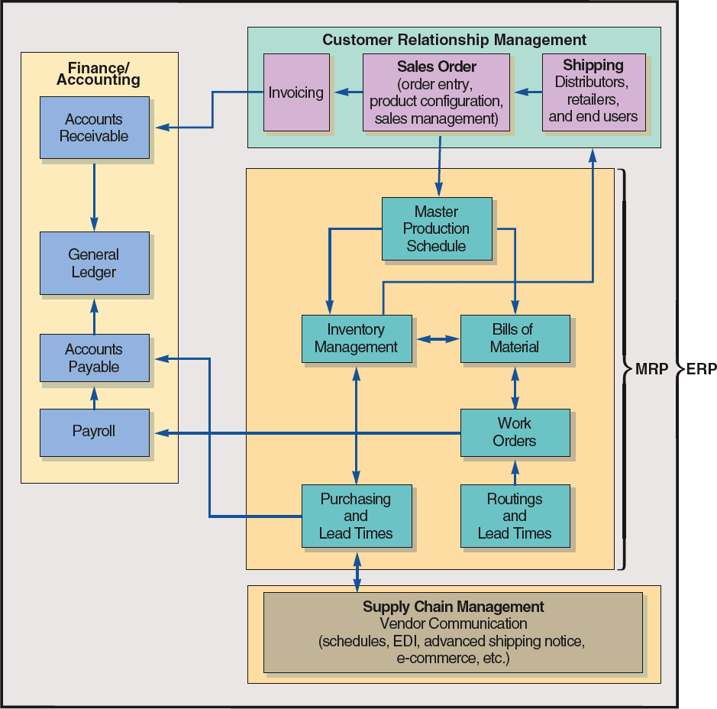
ERP and MRP
Figure 14.11

Slide 59
ERP and MRP
Customer Relationship Management
Sales Order
(order entry,
product configuration,
sales management)
Shipping
Distributors, retailers,
and end users
Invoicing
Figure 14.11

Slide 60
ERP and MRP
Master Production Schedule
Inventory Management
Bills of Material
MRP
Work Orders
Purchasing
and
Lead Times
Routings
and
Lead Times
Table 13.6
Figure 14.11

Slide 61
ERP and MRP
Supply Chain Management
Vendor Communication
(schedules, EDI, advanced shipping notice,
e-commerce, etc.)
Figure 14.11

Slide 62
ERP and MRP
Finance/
Accounting
Accounts Receivable
General Ledger
Accounts Payable
Payroll
Table 13.6
Figure 14.11

Slide 63
Enterprise Resource Planning (ERP)
ERP can be highly customized to meet specific business requirements
Enterprise application integration software (EAI) allows ERP systems to be integrated with
Warehouse management
Logistics
Electronic catalogs
Quality management

Slide 64
Enterprise Resource Planning (ERP)
ERP systems have the potential to
Reduce transaction costs
Increase the speed and accuracy of information
Facilitates a strategic emphasis on JIT systems and integration

Slide 65

All rights reserved. No part of this publication may be reproduced, stored in a retrieval system, or transmitted, in any form or by any means, electronic, mechanical, photocopying, recording, or otherwise, without the prior written permission of the publisher.
Printed in the United States of America.

